Slide 1

Create Emitter (Twitter like app) with SPRING BOOT
Presented by ARMS（THAILAND）Co., Ltd.

Slide 2
Index
Practical Web Development with Spring Boot
Create Emitter
Linking to an External Web-Service
  1-1. Summary
  1-2. Add helper
  1-3. Create a column in table
  1-4. Modify entity class
  1-5. Create a query method
  1-6. Add an avatar to View
Run your app on Server
  2-1. Build and run
  2-2. Challenge
Review
  3-1. Before
  3-2. execution
  3-3. Jointpoint
Review2
  4-1. Basic Attribute
  4-2. Access properties via getter

Slide 3
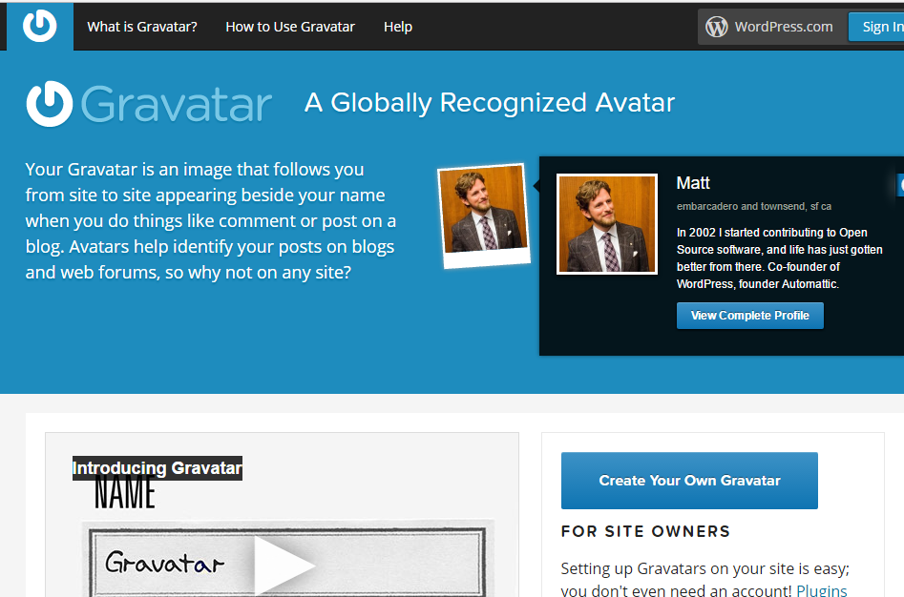
1. Link to an External Web-Service
Practical Web Development with Spring Boot
Create Emitter
1-1. Summary
In this chapter, we will use an external web-service to set an avatar for Emitter user
To set an avatar, we use Gravatar service
https://en.gravatar.com/
https://th.gravatar.com/

Slide 4
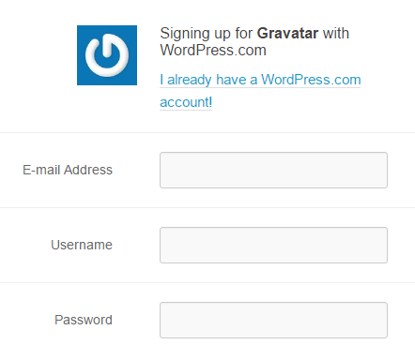
1. Link to an External Web-Service
Practical Web Development with Spring Boot
Create Emitter
1-1. Summary
Sign up for Gravatar and set your avatar you want to use for Emitter
Important point:
Email address you use to sign up for Gravatar has to be the same as the Emitter user’s email address.
Password you use to sign up for Gravatar has to be the same as the Emitter user’s password.
The basic way to access gravatar image is
Gravatar URL + md5hashed email address
http://secure.gravatar.com/avatar/900e4cf039f8ffcb8c628628b71d5387

Slide 5
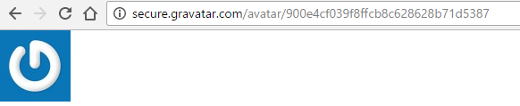
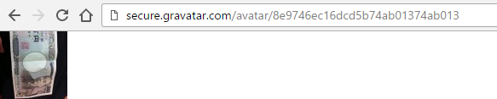
1. Link to an External Web-Service
Practical Web Development with Spring Boot
Create Emitter
1-1. Summary
Gravatar provides us with the helper to create MD5hashed Email address URL
http://secure.gravatar.com/avatar/900e4cf039f8ffcb8c628628b71d5387
If an email address does not exist, the above picture is returned.
If an email address exists, your gravatar is returned.

Slide 6
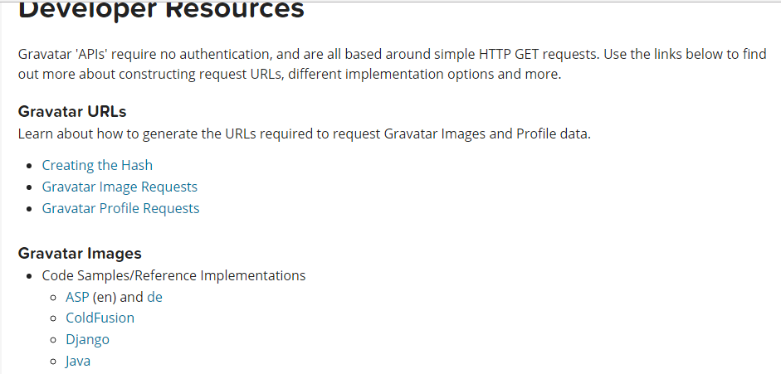
1. Link to an External Web-Service
Practical Web Development with Spring Boot
Create Emitter
1-1. Summary
Gravatar provides us with the helper to create MD5hashed Email address URL
https://en.gravatar.com/site/implement/

Slide 7

1. Link to an External Web-Service
Practical Web Development with Spring Boot
Create Emitter
1-2. Add helper
Create com.arms.app.helpers package
Create Gravatar.java
To encrypt gravatar email in URL, use the code provided by Gravatar website in the next page
Continue on next page

Slide 8
1. Link to an External Web-Service
Practical Web Development with Spring Boot
Create Emitter
1-2. Add helper
Copy the following code to Gravatar.java
package com.arms.app.helpers;
import java.io.UnsupportedEncodingException;
import java.security.MessageDigest;
import java.security.NoSuchAlgorithmException;
public class Gravatar {
public String hex(byte[] array) {
StringBuffer sb = new StringBuffer();
for (int i = 0; i < array.length; ++i) {
sb.append(Integer.toHexString((array[i] & 0xFF) | 0x100).substring(1, 3));
}
return sb.toString();
}
public String md5Hex(String message) {
try {
MessageDigest md = MessageDigest.getInstance("MD5");
return hex(md.digest(message.getBytes("CP1252")));
} catch (NoSuchAlgorithmException e) {
} catch (UnsupportedEncodingException e) {
}
return null;
}
}

Slide 9
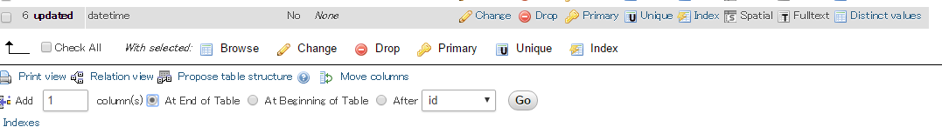
1. Link to an External Web-Service
Practical Web Development with Spring Boot
Create Emitter
1-3. Create a column in table
Create a column in the user table to store Gravatar URL.
Access MySQL on server and add the following column to the user table
Select user table → Structure tab
Add 1 column at end of Table and press Go button
Add a column “avatar” into the table
Or use the following SQL command to add the column
ALTER TABLE `user` ADD `avatar` VARCHAR( 255 ) CHARACTER SET utf8 COLLATE utf8_general_ci NOT NULL ;
Note:When changing table structure, it is important to consider the side effect of doing so

Slide 10
1. Link to an External Web-Service
Practical Web Development with Spring Boot
Create Emitter
1-4. Modify entity class
Add a field “avatar” into the User entity class. And create its getter and setter
Access MySQL on server and add the following column to the user table
public class User {
……………………………………………….
private Date updated;
private List<Micropost> micropostList;
private String avatar;
……………………………………………….
……………………………………………….
……………………………………………….
@Basic
@Column(name = "avatar")
public String getAvatar(){
return "http://secure.gravatar.com/avatar/" + avatar;
}
public void setAvatar(String avatar){
this.avatar = avatar;
}
}

Slide 11
1. Link to an External Web-Service
Practical Web Development with Spring Boot
Create Emitter
1-5. Create a query method
Create a query method in UserRepository
@Repository
public interface UserRepository extends JpaRepository<User, Integer> {
User findOneByEmail(String email);
User findAvatarById(int id);
Page<User> findByIdInOrderByUpdatedDesc(Collection id, Pageable pageable);
}
Auto-generate SQL
User findAvatarById(int id);
Note: JPA has a simple version of SQL called JPQL, which can access database

Slide 12
1. Link to an External Web-Service
Practical Web Development with Spring Boot
Create Emitter
1-5. Create a query method
Example of query method
User findByAAAandBBB
From User where AAA = ?1 and BBB = ?2
User findByAAAOrBBB
From User where AAA = ?1 Or BBB = ?2
User findByAAAGreaterThan(LessThan)
From User where AAA >(<) 1?
User findByAAAIsNull(IsNotNull)(NotNull)
From User where AAA is null
User findByAAALike(NotLike)
From User where AAA Like ?1
Continue on next page

Slide 13
1. Link to an External Web-Service
Practical Web Development with Spring Boot
Create Emitter
1-5. Create a query method
Example of query method
User findByAAAOrderByBBBAsc
From User where AAA = ?1 order by BBB Asc

Slide 14
1. Link to an External Web-Service
Practical Web Development with Spring Boot
Create Emitter
1-6. Add an avatar to View
Call the query method from Service
Generate gravatar URL
Add the following code to AppService
public String getGravatarUrl(String email) {
Gravatar graCtrl = new Gravatar();
String gravatarId = graCtrl.md5Hex(email);
return gravatarId;
}
public String findAvatar(int id){
return userRepository.findAvatarById(id).getAvatar();
}

Slide 15
1. Link to an External Web-Service
Practical Web Development with Spring Boot
Create Emitter
1-6. Add an avatar to View
Change createUser() in UserService to create a URL when a user is created.
Add the following code to createUser() method in UserService
public void createUser(UserAddForm userAddForm) throws NoSuchAlgorithmException {
Date nowDate = Calendar.getInstance().getTime();
User user = new User();
user.setName(userAddForm.getName());
user.setEmail(userAddForm.getEmail());
user.setPassword(passwordEncoder.hashMD5(userAddForm.getPassword()));
user.setCreated(nowDate);
user.setUpdated(nowDate);
user.setAvatar(getGravatarUrl(userAddForm.getEmail()));
userRepository.save(user);
}

Slide 16
1. Link to an External Web-Service
Practical Web Development with Spring Boot
Create Emitter
1-6. Add an avatar to View
Restart your app and access ---------:8080/, and create a user
Go to MySQL and check if the new user has a value in the avatar field.

Slide 17
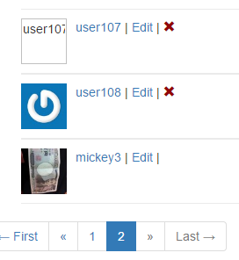
1. Link to an External Web-Service
Practical Web Development with Spring Boot
Create Emitter
1-6. Add an avatar to View
Display gravatar on template.user list.html
<span th:each="user, stat : ${users}">
<ul class="users">
<li>
<img th:src="${user.avatar}" width="52" height="52" th:alt="${user.name}" class="gravatar"/>
<a th:href="@{/user/show/} + ${user.id}" th:text="${user.name}">AAA</a>
<span>|</span>
<a th:href="@{/user/edit/} + ${user.id}" th:text="'Edit'">BBB</a>
……………………………………………………………..
th:each “user, stat : “${users}
Repeat as
th:src"${user.avatar}“
Gravatar id with email
No gravata id with email
th:alt="${user.name}”
no image

Slide 18
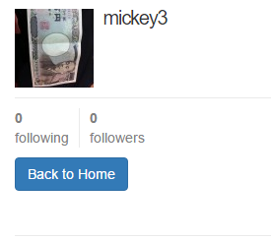
1. Link to an External Web-Service
Practical Web Development with Spring Boot
Create Emitter
1-6. Add an avatar to View
Display gravatar on template.user show.html
<aside class="col-xs-4">
<section>
<h1>
<img th:src="${user.avatar}" th:alt="${user.name}" class="gravatar"/>
<span th:text="${user.name}">AAA</span>
</h1>
</section>
……………………………………………………

Slide 19
1. Link to an External Web-Service
Practical Web Development with Spring Boot
Create Emitter
1-6. Add an avatar to View
Display gravatar on template.user edit.html
<div class="text-center">
<input class="btn btn-primary btn-large" type="submit" name="submit" value="Update my account" /><br/><br/>
</div>
</form>
<h2 th:text="${user.name}">user name (replaced with image)</h2>
</div>
</div>
Replace the above part with the following code
<div class="text-center">
<input class="btn btn-primary btn-large" type="submit" name="submit" value="Update my account" /><br/><br/>
</div>
</form>
<img th:src="${user.avatar}" th:alt="${user.name}" class="gravatar"/>
<a href="http://gravatar.com/emails">change</a>
</div>
</div>

Slide 20
1. Link to an External Web-Service
Practical Web Development with Spring Boot
Create Emitter
1-6. Add an avatar to View
Display gravatar on template.user list.html
<aside class="col-xs-4">
<section>
<h1>
<img th:src="${user.avatar}" th:alt="${user.name}" class="gravatar"/>
<span th:text="${user.name}">AAA</span>
</h1>
</section>
……………………………………………………

Slide 21
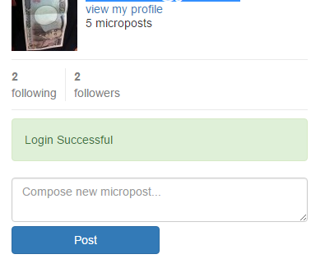
1. Link to an External Web-Service
Practical Web Development with Spring Boot
Create Emitter
1-6. Add an avatar to View
Display gravatar on template.shared _user_info.html
<div th:fragment="user_info" th:remove="tag">
<!-- shared _user_info.html included into home.html -->
<a th:href="@{/user/show/} + ${userId}">
<img th:src="${userImage}" th:alt="${userInfo.username}" class="gravatar"/>
</a>
<h1 th:text="${userInfo.username}">AAA</h1>
………………………………………………………………………………
Also add the following code to home() method in HomeController
……………………………………………………………………………
if(userId != null){
modelAndView.addObject("userId", userId);
modelAndView.addObject("userImage", homeService.findAvatar(userId));
modelAndView.addObject("following", homeService.getFollowingListByUserId(userId));
…………………………………………………………………………
This time if you want to check, you need to restart your app because you change the java code.

Slide 22
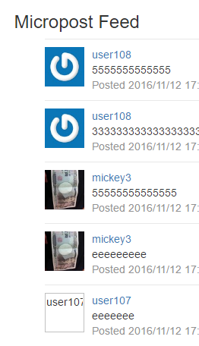
1. Link to an External Web-Service
Practical Web Development with Spring Boot
Create Emitter
1-6. Add an avatar to View
Display gravatar on template.shared _feed_item.html
<div th:fragment="feed_item(micropost)" th:remove="tag">
<!-- shared _feed_item.html included into _feed.html -->
<li th:id="${micropost.id}">
<img th:src="${micropost.user.avatar}" width="52" height="52" th:alt="${micropost.user.name}" class="gravatar"/>
<span class="user">
<a th:href="@{/user/show/} + ${micropost.user.id}" th:text="${micropost.user.name}">AAA</a>
</span>
………………………………………………………………………………

Slide 23
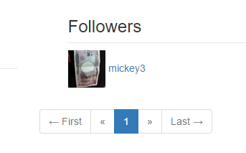
1. Link to an External Web-Service
Practical Web Development with Spring Boot
Create Emitter
1-6. Add an avatar to View
Display gravatar on template.user followers.html
<div class="row">
<aside class="col-xs-4">
<section>
<h1>
<img th:src="${user.avatar}" th:alt="${user.name}" class="gravatar"/>
<span th:text="${user.name}">AAA</span>
</h1>
</section>
<section>
<div th:include="shared/_stats :: stats">stats</div>
</section>
</aside>
<div class="col-xs-8">
<ol>
<h3>Followers</h3>
</ol>
<ol class="microposts">
<span th:each="user, stat : ${followers}">
<li>
<img th:src="${user.avatar}" width="52" height="52" th:alt="${user.name}"/>
<span class="user">
<a th:href="@{/user/show/} + ${user.id}" th:text="${user.name}">AAA</a>
</span>
</li>
</span>
</ol>
……………………………………………………

Slide 24
2. Run your app on Server
Practical Web Development with Spring Boot
Create Emitter
2-1. Build and run
In this section, build and run your application on Server
$vagrant ssh
[vagrant@localhost ~]$ cd /vagrant
[vagrant@localhost vagrant]$ cd emitter/
[vagrant@localhost emitter]$ gradle build
[vagrant@localhost emitter]$ java -jar build/libs/emitter-0.1.3-SNAPSHOT.jar
After your app is started, check if your app is ok on Server
Access the following URL
http://192.168.33.10:8080/

Slide 25
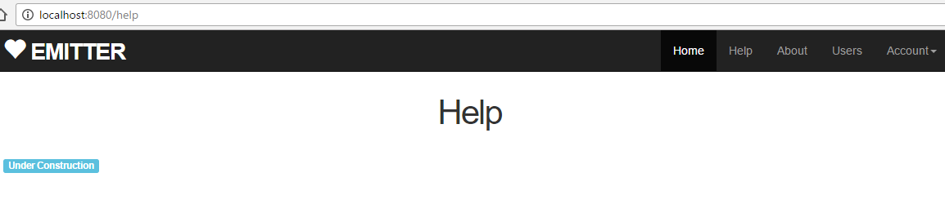
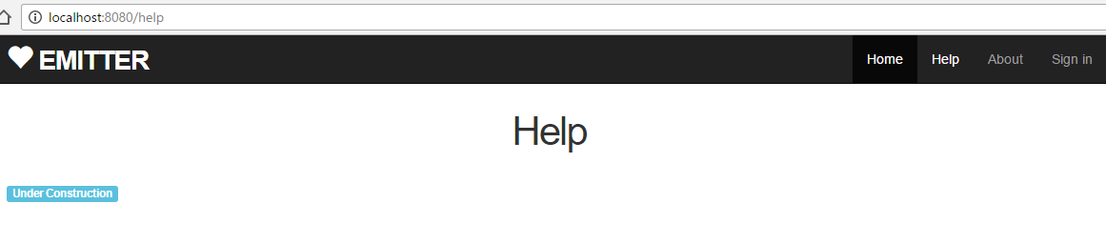
2. Run your app on Server
Practical Web Development with Spring Boot
Create Emitter
2-2. Challenge
Correct staticpages error
Change the staticpages to keep login status

Slide 26
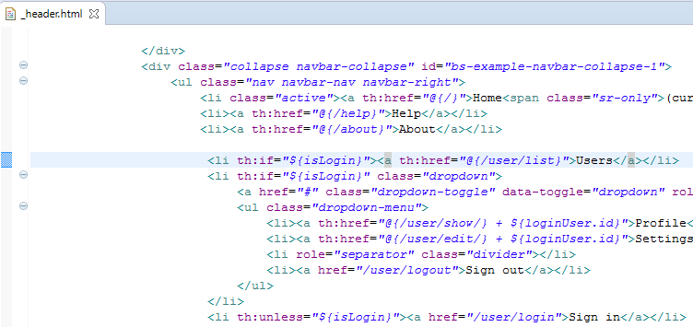
2. Run your app on Server
Practical Web Development with Spring Boot
Create Emitter
2-2. Challenge
See AOP controllerAspect
@Before("execution(* com.arms.app.*.*Controller.*(..))")
public void invokeBefore(JoinPoint joinPoint) {
…………………………………………………………
if(principal != null && modelAndView != null) {
setIsLogin(modelAndView, principal);
}
}
private void setIsLogin(ModelAndView modelAndView, Principal principal) {
Authentication auth = (Authentication) principal;
if(auth != null && auth.isAuthenticated()) {
modelAndView.addObject("isLogin", true);
UserDetails userDetails = (UserDetails) auth.getPrincipal();
modelAndView.addObject("userInfo", userDetails);
modelAndView.addObject("loginUser", appService.findOne(principal));
} else {
modelAndView.addObject("isLogin", false);
}
}
In AOP code, it checks if you login or not for each controller

Slide 27
2. Run your app on Server
Practical Web Development with Spring Boot
Create Emitter
2-2. Challenge
When principal object is not null, for example, “isLogin” false
<li th:if="${isLogin}" class="dropdown"> - true
<li th:unless="${isLogin}"><a href="/user/login">Sign in</a></li> -false
StaticPagesController
@RequestMapping("/help")
public String help( ){
return "static/help";
}
No Principal, isLogin false

Slide 28
2. Run your app on Server
Practical Web Development with Spring Boot
Create Emitter
2-2. Challenge
If you don’t use AOP, your code will be …like below
StaticPagesController
@RequestMapping("/help")
public ModelAndView help(ModelAndView modelAndView, Principal principal){
controllerAspect.setIsLogin(modelAndView, principal);
modelAndView.setViewName("static/help");
return modelAndView;
}
@RequestMapping("/about")
public ModelAndView help(ModelAndView modelAndView, Principal principal){
controllerAspect.setIsLogin(modelAndView, principal);
modelAndView.setViewName("static/about");
return modelAndView;
}
@RequestMapping("/contact")
public ModelAndView help(ModelAndView modelAndView, Principal principal){
controllerAspect.setIsLogin(modelAndView, principal);
modelAndView.setViewName("static/contact");
return modelAndView;
}
……………………

Slide 29

2. Run your app on Server
Practical Web Development with Spring Boot
Create Emitter
2-2. Challenge
You have to ask each developer to insert setIsLogin method……..
StaticPagesController
@RequestMapping("/help")
public ModelAndView help(ModelAndView modelAndView, Principal principal){
controllerAspect.setIsLogin(modelAndView, principal);
modelAndView.setViewName("static/help");
return modelAndView;
}
This is not a smart way, the same code..again and again..
AOP is helpful in this kind of case
@RequestMapping("/help")
public ModelAndView help(ModelAndView modelAndView, Principal principal){
modelAndView.setViewName("static/help");
return modelAndView;
}

Slide 30
2. Run your app on Server
Practical Web Development with Spring Boot
Create Emitter
2-2. Challenge
Cross-cutting concerns
Essential code is in each controller, cross-cutting concerns which are not essential are in Aspect
Controller A
Controller B
Controller C
Code A
Security
Code B
Code C
Code D
Security
Code E
Code F
Security
Security
Cross-cutting concerns

Slide 31
2. Run your app on Server
Practical Web Development with Spring Boot
Create Emitter
2-2. Challenge
Cross-cutting concerns
Aspect : security ( in this case )
Class XXX
Method A
Method B
Pointcut:
Definition of
execution
Advice:
Common code
Joint point
Before
After
Around
point where cross-cutting concerns is executed
Code which is run at jointpoint
("execution(* com.arms.app.*.*Controller.*(..))")
pointcut expression to qualify which bean AOP is intercepting.

Slide 32
3. Review
Practical Web Development with Spring Boot
Create Emitter
3-1. Before
Before advice
@Before("execution(* com.arms.app.*.*Controller.*(..))")
Advice: Aspect code put into JointPoint
Type of Advice:
Before Advice: executes before a Jointpoint
After Advice: executes after a Jointpoint
Around Advice: Executes around a jointpoint

Slide 33
3. Review
Practical Web Development with Spring Boot
Create Emitter
3-2. execution
execution syntax
execution is used to specify the execution target of Spring AOP.
execution(“modifier” “return value” package.class.method(args) “throws exception”)
Red letters can be abbreviated.
@Before("execution(* com.arms.app.*.*Controller.*(..))")
* can be matched for all, in this case return value
com.arms.app.* package
*Controller can be matched for ****Controller
*(..))") can be matched for all methods and arguments
(*,*) can be matched for two arguments
If you don’t use “execution”, all methods are targeted for AOP….
Notes:
http://javatechnology.net/spring/execution-format/

Slide 34
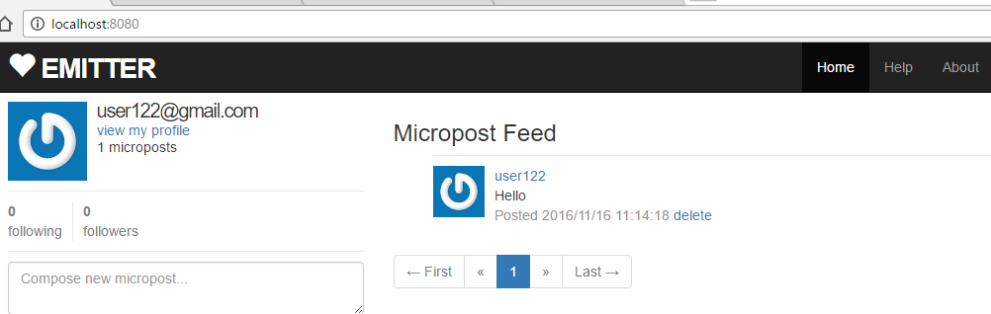
3. Review
Practical Web Development with Spring Boot
Create Emitter
3-3. Jointpoint
Jointpoint
example from Emitter:
public void invokeBefore(JoinPoint joinPoint) {
joinPoint
execution(ModelAndView com.arms.app.home.HomeController.home(ModelAndView,Principal,Pageable))
When you access home page(), jointPoint object has the above value.
Continue on next page

Slide 35
4. Review2
Practical Web Development with Spring Boot
Create Emitter
4-1. Basic attribute
@Basic annotation
A basic attribute value can map directly to the column value in the database.
Example:
String (char, char[]) ⇒ VARCHAR (CHAR, VARCHAR2, CLOB, TEXT)
Number (Integer, Double, Long, Float, Short, Byte) ⇒ NUMERIC (NUMBER, INT, LONG, FLOAT, DOUBLE)
java.util.Date ⇒ TIMESTAMP (DATE, DATETIME)
The easiest way to map a basic attribute in JPA is to do nothing. Any attributes that have no other annotations and do not reference other entities will be automatically mapped as basic. When you reach a point where you want to change a basic attribute for your database, to specify the column name for a basic attribute the @Column annotation.
Continue on next page

Slide 36
4. Review2
Practical Web Development with Spring Boot
Create Emitter
4-2. Access properties via getters
Access properties via getters
Putting annotations on getters is useful when your object state is different from database schema
@Column(name = "user_id")
public Integer getUserId() {
return userId;
}
@Column(name = "avatar")
public String getAvatar(){
return "http://secure.gravatar.com/avatar/" + avatar;
}
@Entity
public class User {
private String firstName;
private String middleName
private String lastName;
private int age;
@Column(name = "U_NAME")
public String getName() {
return fisrtName + " " + middleName + " " +lastName;
Once you put annotations on getter, other should be also put on getter.

Slide 37

Your Idea Leads Your Ideals
homepage: http://arms-asia.com/
facebook: https://www.facebook.com/arms.asia?fref=ts
Notes:
If you follow document, next class is very easy

